Slide 1

Guided Pathways
Core Team Presentation
Winter 2019

Slide 2
Mission Statement – Reaffirmed in Spring 2018
De Anza College provides an academically rich, multicultural learning environment that challenges students of every background to develop their intellect, character and abilities; to realize their goals; and to be socially responsible leaders in their communities, the nation and the world. The college engages students in creative work that demonstrates the knowledge, skills and attitudes contained within the college’s Institutional Core Competencies:
Communication and expression
Information literacy
Physical/mental wellness and personal responsibility
Civic capacity for global, cultural, social and
environmental justice
Critical thinking

Slide 3

What Does De Anza Mean to You?
COMMUNITY • EDUCATION
EQUITY • OPPORTUNITY

Slide 4
Why Are We Doing This?
California is encouraging community colleges
to adopt the Guided Pathways model to help students achieve their goals.
De Anza has one of the highest transfer and completion rates in the state – but other colleges are catching up. And, we can do better.
The college obtained a grant to develop a Guided Pathways plan and put it into effect over the next five years.
To begin the process, a core team is introducing the concept and gathering input.

Slide 5
First-Time Students Who Entered in Fall 2015
Almost all first-time students intend to complete a certificate, degree or transfer
Almost half of all students are African American, Latinx or Filipinx
Within 3 years:
  13% (417)
  obtained a degree or certificate
  58% (3,154)
  did not achieve their goal
  29% (905)
  transferred to a university

Slide 6


Actualizing De Anza’s Mission and Vision
The Guided Pathways framework creates a highly structured approach to student success
Providing all students with a set of clear course-taking patterns that promotes better enrollment decisions and prepares students for future success
Integrating support services to make it easier for students to get the help they need during every step of their college experience

Slide 7


Four Pillars of Guided Pathways
Create clear
curricular
pathways to degrees, certificates and other goals.
Group related majors and programs together for easier pathway mapping.
Help students choose and
enter the right
pathways, including bridges from high school to college and on-ramps to programs of study.
Help students stay on their path, with
Active, ongoing advising
Integrated academic and nonacademic supports
Ensure learning with
Effective instructional practices
Engaging, applied learning experiences
Intentional outcomes aligned to employer or transfer expectations

Slide 8
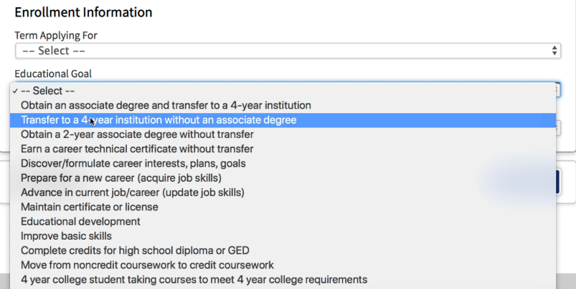
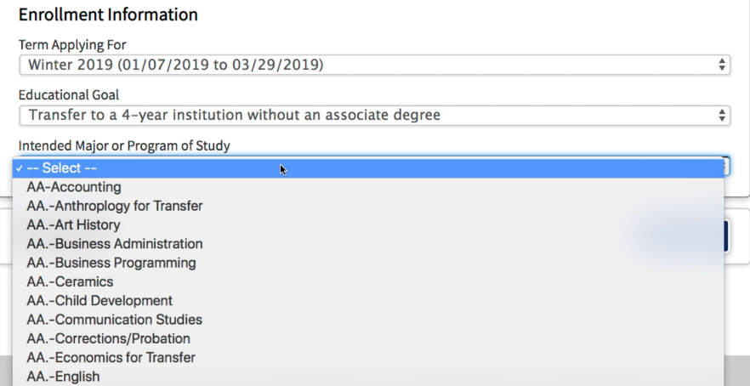
}
Challenges – In the Words of Our Students
Picking a major has been very tough for me because I’m stuck between so many options ...
My original intentions as a kid were to ultimately be a lawyer. I then grew up loving the medical field. As of right now, I have switched majors from Biological Sciences to Political Science and I'm [still] not sure if this is the right path for me ...
I was stuck believing that I had to go to STEM because of societal pressures, but as the weeks go on I realized that my passion lies in English and literature ...
}

Slide 9
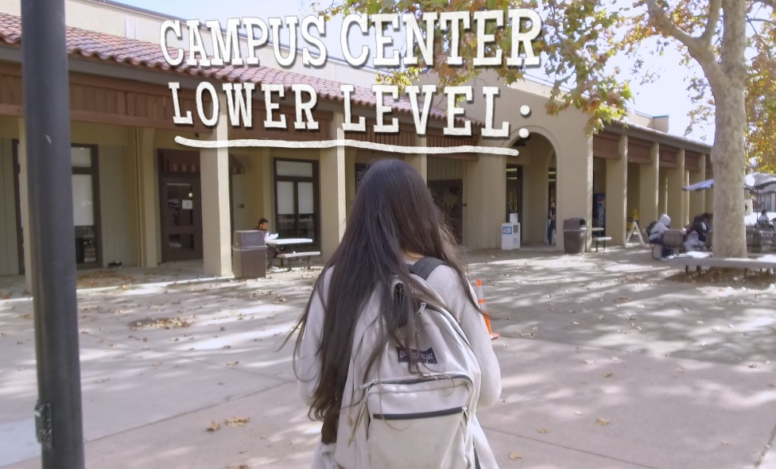
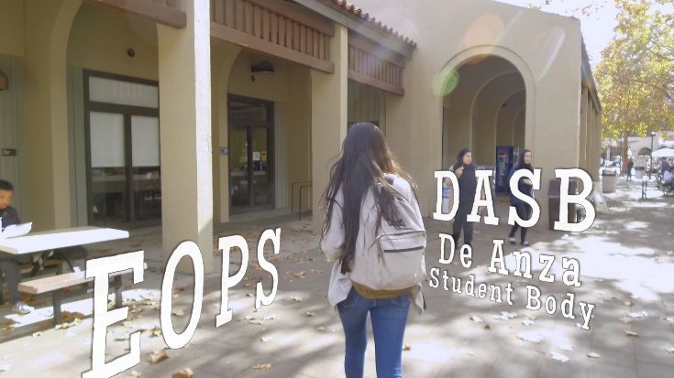
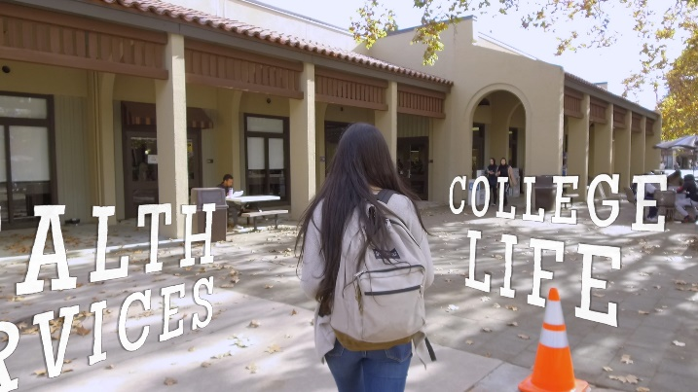
}
Challenges – In the Words of Our Students
I would not have known about programs and resources
... if it were not for my sister or some friends, or unless I went to the Campus Center very often and, other than coming to buy food at the cafeteria, I [don’t] exactly have much reason to do so.
I know people who have taken Counseling [5] classes and have learned about things like DASB, but those who haven't taken those classes – like me – wouldn’t.
}
Images from Campus Video Tour

Slide 10
Timeline
Winter Quarter 2019
Share concept with campus community
Dig deeper at the Convocation on Feb. 22
    Kirsch Center, Room 115
    Lunch provided to attendees
Use feedback to implement our model
    Form collaborative teams
    Set goals and outcomes by summer 2019
Work in collaborative teams to design our Guided Pathways model throughout 2018-19

Slide 11
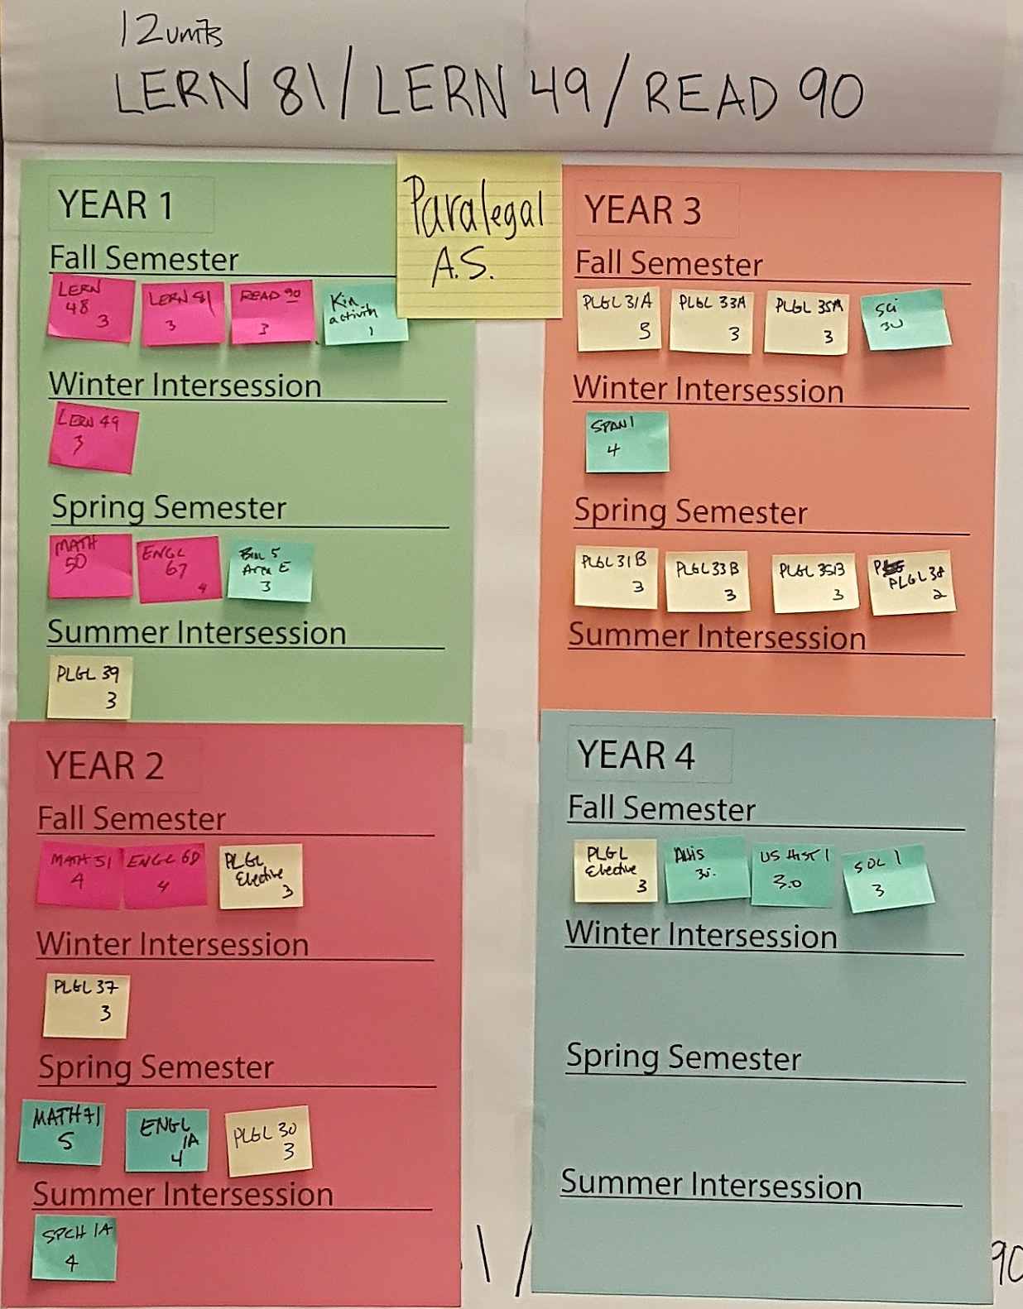

Case Study: Mt. San Antonio Course Sequencing
Cross-functional faculty and staff teams, including
Counseling
Student support
Instructional faculty (content
area, English, Math, ESL, Reading, Library and others)
Teams worked on
Ordering of courses for each degree and certificate
Examining where students
should obtain support
services along the way

Slide 12
How Can I Get Involved?
Visit the Guided Pathways webpage for more information and opportunities
deanza.edu/guided-pathways
We are seeking participation from faculty members, students, classified professionals and administrators
Questions?

Slide 13
Guided Pathways
Core Team Presentation
Winter 2019

